Slide 1


PREDICTING CLIENT SUBSCRIPTION TO TERM DEPOSITS
BY: KEZIAH PRABA BONZO
TECHNICAL ASSESSMENT

Slide 2

Overview
Introduction
03
Dataset Overview
04
Data Preparation and Feature Eng.
05
Machine Learning Approach
06
Final Model Performance
07
Conclusion
08
Recommendation
09

Slide 3
INTRODUCTION
The objective of this project is to build a machine learning model to predict whether a client will subscribe to a term deposit by using client demographics and marketing campaign-related features.

Slide 4
DATASET OVERVIEW
Total Observations: 45,211.
Variables: 17 (7 numerical, 10 categorical)
Target Variable: y (yes/no)
Class Imbalance Identified:
Yes (Subscribed): 5,289 (~12%)
No (Not Subscribed): 39,922 (~88%)

Slide 5
DATA PREPARATION & FEATURE ENGINEERING
Conducted Exploratory Data Analysis (EDA) to identify patterns, correlations, and any necessary data preprocessing steps.
Removed or imputed 'unknown' values in categorical fields.
Outliers in numerical features treated using mean imputation.
Encoded categorical variables using One-Hot Encoding.

Slide 6
MACHINE LEARNING APPROACH
Techniques Used
Challenge:
Random Forest Classifier
XGB Classifier
Voting Classifier (Ensemble)
Hyperparameter Tuning (GridSearchCV)
Final Model: Tuned Random Forest Classifier
F1-score for 'yes' class remained consistently low despite trying different models and techniques.
SMOTE was applied to balance the dataset and improve sensitivity to the minority class.

Slide 7
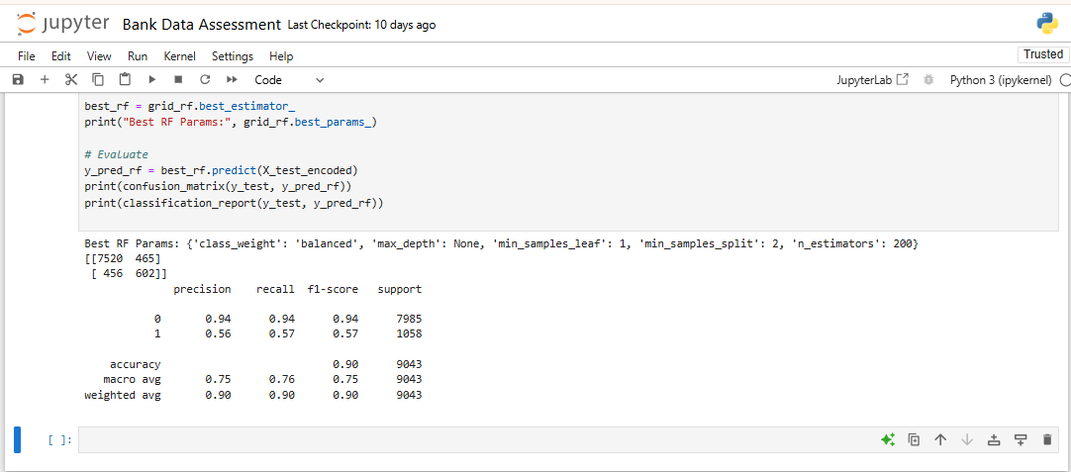
FINAL MODEL PERFORMANCE
Accuracy: 90%
F1-Score (yes): 0.57
Confusion Matrix:
TP: 602, TN: 7520, FP: 465, FN: 456
Despite model changes and resampling, identifying subscribers remained challenging due to overlapping patterns and limited signal strength in features.

Slide 8
CONCLUSION
The model achieved high overall accuracy (90%), it still struggled to improve F1 performance for the 'yes' class beyond a certain point.
This underscores a critical insight: data quality, feature richness, and business context are just as important as modeling technique.

Slide 9
RECOMMENDATIONS
Business:
Model:
Data:
Record reasons for non-subscription, if possible, to enrich feature sets for future campaigns.
Monitor target distribution during data collection to detect and flag imbalance early.
Further explore feature collection (e.g. Income, channels) to boost performance.

